Slide 1


Data Governance @ SneakerPark
Prepared by: ThuHTH
Submitted on: Nov 18th, 2022

Slide 2
Background
SneakerPark is an online shoe reseller that allows people to buy and sell used and new shoes. Buyers can bid for shoes or buy them outright, and sellers can set a price or sell to the highest bidder.
Each buyer and seller must have an active account in order to sell, bid, or purchase sneakers using SneakerPark’s website.
SneakerPark authenticates the shoes before shipping them to the buyer, so before listing an item, the seller must ship it to SneakerPark’s warehouse. Upon receipt, SneakerPark assigns an item number to each pair of sneakers and notifies the seller that they are now free to list their item. If the item is not listed within 45 days, SneakerPark returns it to the seller and sends an invoice to the seller for the shipping cost.
If the item is found to be inauthentic or in an unacceptable condition, it is also returned back to the seller in a similar fashion.
When the item sells, the buyer’s account is credited with the purchase price minus the SneakerPark service fee and shipping fees to deliver the item to the buyer.
Currently, SneakerPark only supports sales within the United States.

Slide 3
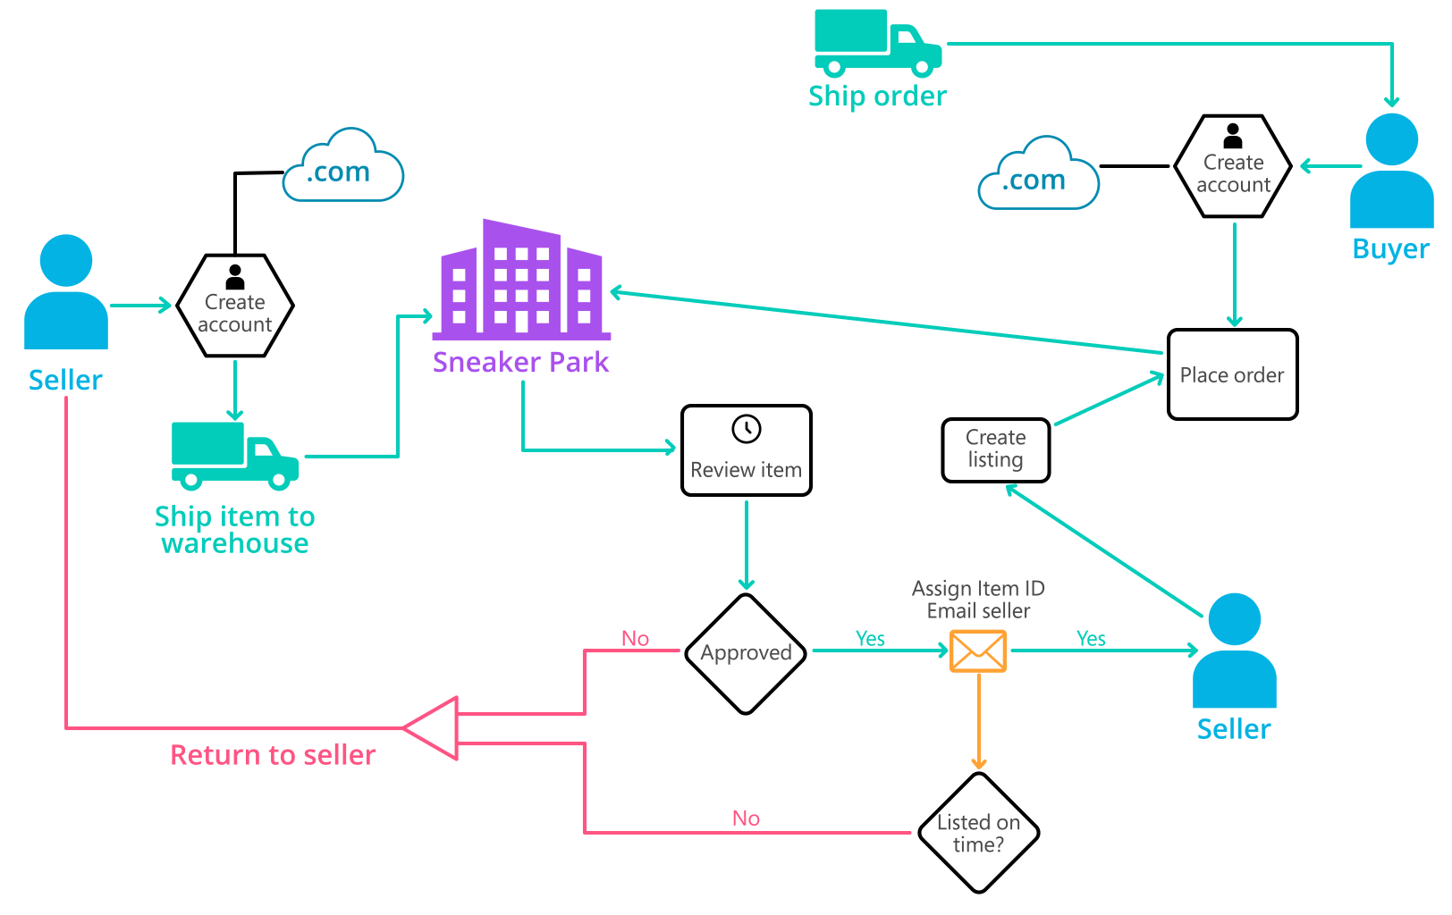
Background (cont’d)
Below you can see a diagram that will hopefully help you visualize some of SneakerPark's business processes. Keep in mind that it does not capture ALL processes and every nuance, but simply serves as another artifact to use in your project.

Slide 4
Step 1
Enterprise Data Catalog Part 1: Enterprise Data Model

Slide 5
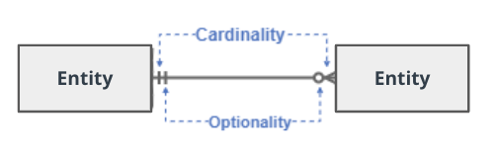
Create a conceptual data model that will provide SneakerPark with a holistic view of its data systems and help you grasp the organization's important entities and relationships, which will be instrumental as you move further in the project. You can use Lucidchart or any other diagramming tool of your choice, but please use the Crow’s Foot/IE Notation and please be sure to indicate both cardinality (the type of a relationship such as 1:N or N:N) and optionality (whether the relationship is optional or mandatory).

Slide 6
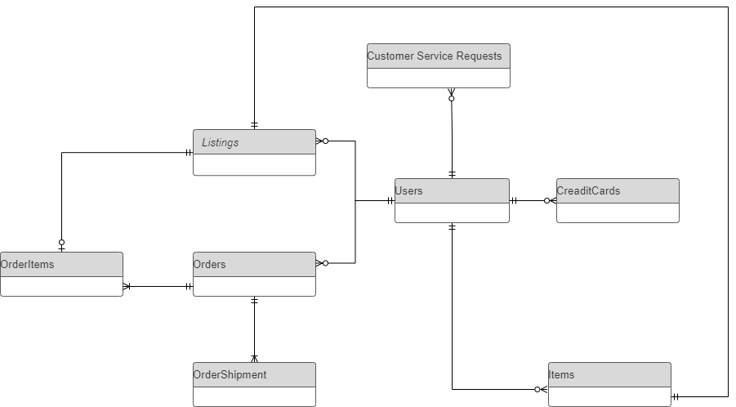
Replace the example below with your own solutions (obviously feel free to take more space):

Slide 7
Step 2
Enterprise Data Catalog Part 2: Metadata

Slide 8
Create the first version of the Metadata Catalog by documenting the metadata from all systems in the "Data Dictionary" and the “Enterprise Data Catalog” tabs of the provided Sheets template.
Please note that you are required to fill out all fields in both tabs.

Slide 9
Step 3
Data Quality
Part 1: Profiling and Cleansing

Slide 10
Profile the data to identify at least 3 data quality issues you see in the data. Also provide at least 1 data quality issue that you haven’t yet seen in the data, but can foresee occurring in the future. Based on the issues you’ve identified, come up with the data quality rule for each data quality issue, including for the one that you foresee.
Make sure you fill out all columns in the "Data Quality Issues" tab with your answers in the provided Sheets template.

Slide 11
Step 4
Data Quality
Part 2: Monitoring

Slide 12
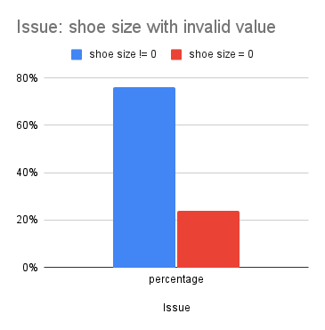
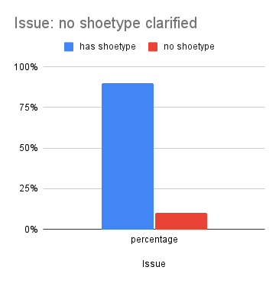
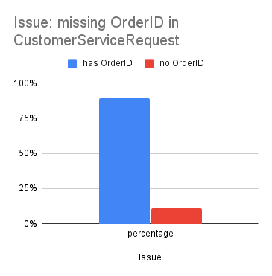
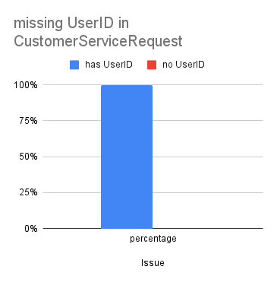
Using the metrics you've created in the last step, please create a mock-up of a data quality monitoring dashboard that will be used to monitor the data to ensure compliance with your data quality rules.
Please make sure to label your metrics clearly on your mock-up.

Slide 13
Step 5
Master Data Management
Part 1: MDM Architecture

Slide 14
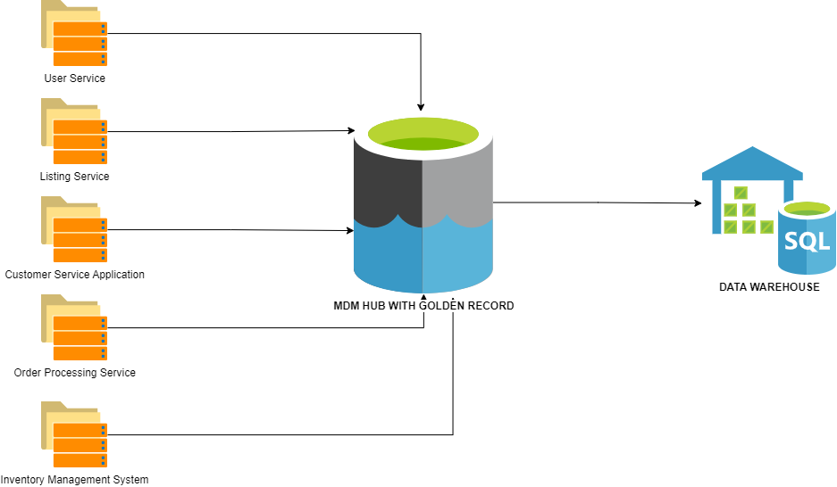
Based on what you’ve read about SneakerPark’s systems and business model, sketch out a proposed MDM implementation architecture, and write a detailed explanation of why you chose this specific approach.
Tip: Think about how your plan and its implementation might affect existing systems.

Slide 15
Explanation:
With the thorough reviewing and evaluating company requirement, I will propose we go with a consolidation style master data management system.
Also to prepare for establishing an enterprise data warehouse in phase 2, the consolidation one would be a more proper solution instead of the registry style - which can be too unvaried and simple.
Since SneakerPark as well noted that there should be minimal disruption to its existing systems of User and Customer service application, or Order Processing system, the most optimal solution that supports high quality data flow should be through a consolidated MDM - where data consolidation happens in the MDM hub.
Otherwise, if carrying on with any other MDM, this would affect the source systems - which violating the business requirements.
When consolidating data from all systems into a MDM hub, this will help to merge, transform and clean data into golden records for the data warehouse and existing reports.
This solution also support the most for maintaining the quality for master data, help the team to quickly spotlight any data analysis issues that may arise and establish rules and processes to improve accordingly

Slide 16
Step 6
Master Data Management
Part 2: Master Record

Slide 17
In this step, you will define a set of matching rules that will be used by the SneakerPark's MDM Hub to match item and customer entities between the company's different systems.
Please come up with 4 rules - 2 for Items and 2 for Customers and list them below.
Rules for Items:
Primary rule: Items with the same listingID
Items that have the same combination of these attributes: brand, type, gender, color, condition, sellerID, size and listingcreatedate
Rules for Customers:
Primary matching rule: User with the same userID
Users with the same email address and phone, firstname and lastname

Slide 18
Step 7
Data Governance:
Roles and Responsibilities

Slide 19
Write 1-2 paragraphs discussing what data governance roles and responsibilities will be necessary to oversee this new Data Management initiative. Please be sure to discuss the responsibilities in the context of at least 3 different aspects of Data Governance (such as Data Quality Management, Metadata Management, MDM, etc). Based on what you know, do SneakerPark's current employees have the necessary skills for these roles or should the company make new hires?
Current Employee evaluation:
Jake - IT support - can participate in database administration tasks, but for more technical and expertises in managing the enterprise data management, he will need a lot more training and practicing
Jessica - Senior Business Analyst - a subject-matter-expert when it comes to Sneaker Park's data. She has been instrumental in diagnosing data issues and finding solutions, but it has been increasingly difficult to keep up as she does this in addition to her other responsibilities.

Slide 20
Proposed roles and responsibilities:
Data Steward for data quality and MDM: who play the role of curating the data and maintain the data highest quality. They should be in charge of detecting suspicious records that can be identified automatically and expose issues related. In terms of MDM, the data steward will help to establish match rules, review records or create golden records.
Data Administrators for metadata management: who can set up a unified system, communicate with different technical departments of all systems to update and correct the metadata to be always up-to-date.
Furthermore, we can have a consultant role for advanced matters such as creating the data flow and pipelines that will load data from different sources to the consolidated system. For the ongoing maintenance, the consultant can help to provide needed trainings and review for the current team members to perform the job.

Slide 21
Thank you

